Slide 1
Pages and Page Layout
Presented by:
Amandeep Kaur GuriqbalSingh Sandhu (8683190)
Joshna Thankamma Thomas (8673020)
Piyush Sachdeva (8671378)
Kartik Velede (8672807)
Agam Kumar (8673031)

Slide 2
Introduction
HR department in the organization wants a intranet site for the following reasons:
To support the employees with a centralized workplace
To help the recruitment process
To track the performance of the employee and encourage them.
Providing training to new recruited members
This slides show give you brief insight about the pages, web-parts and part that are used in order to develop an SharePoint site for HR department

Slide 3
Web-Part page
In webpart pages you can modify the content appearance and behavior of the page. This page consist of web-part zone where you can add and configure webparts and apps
Intranet site for HR department has a web-part page to display the following things.
Announcements about the change in the process and any events happening in the company
A place to check the details of employees and their roles
An application to schedule meetings, book an appointment
Quick links to navigate between pages

Slide 4
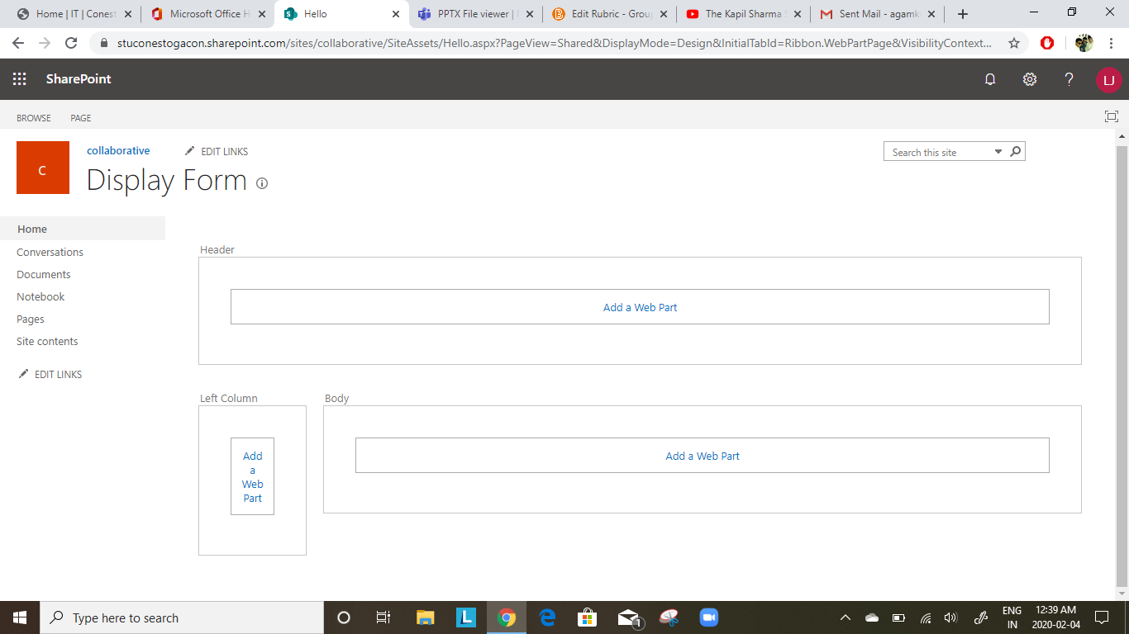
Reasons
Gives good look and feel
Can easily modify and add contents
Facilitate Teamwork
Enhance team productivity
The layout that is used for webpart
Is 1 Header, 1 Column , 1 body

Slide 5
Wiki Page
Wiki Page are stored in site-page library
The HR department uses wiki page to store the following things
Knowledge base - To document and share the project details and place to view policy information
Employee onboarding - Training videos , documents, links to share with new employees
Frequently Asked Question – A place to view frequently asked question by employees

Slide 6
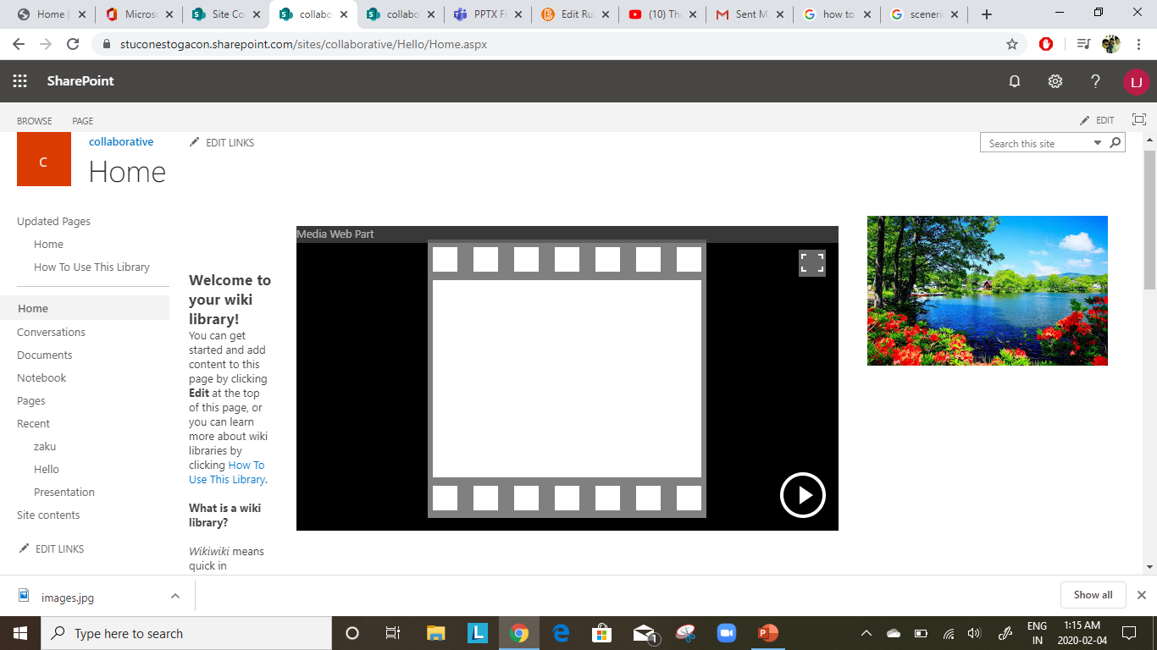
Reasons
Improves collaboration between the employees
Knowledge base which reduces the time of the trainer to teach new employees
The layout that is used for wiki page is three columns

Slide 7
Publishing Page
Publishing can be altered the way you want your page to look
Every HR department does background check for there employees to make sure that His/her is qualified for the job.
HR department wants to build this page with certain fields that they want.
Example : They wanted to build an employee profile page with following fields with in it
Name
Date of birth
Government ID
After filling these details these page has an option submit , by clicking on it the particular person gets an alert of your file for the approval
You can also give your ideas and thoughts of policy improvement to cover the business gap through publishing page which needs approval to go live .

Slide 8
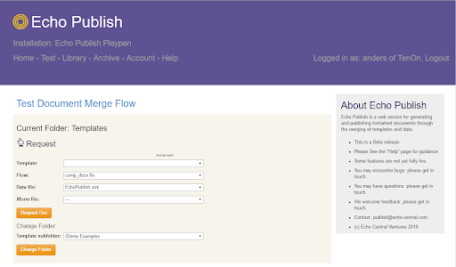
Reasons
Good level of control in creating a page.
Metadata is setup automatically for every new page (Makes Searching very efficient).
Layout used is two columns and 1 Header.

Slide 9
Web Parts and Apps
The following are the web parts and apps that used for the SharePoint site
News feed app for announcement
Custom list for storing employees details
Wiki page library for storing all policies, training videos and Knowledge base
Calendar app for setting up meetings
Quick links for navigation purpose

Slide 10
References
Echo Publish. (n.d). Retrieved from http://playpen.echopublish.com/guide/
Microsoft. (2019, 05 18). SharePoint. Retrieved on (04 Feb 2020) from Microsoft Doc: https://docs.microsoft.com/en-us/sharepoint/dev/general-development/how-to-create-a-page-layout-in-sharepoint
Smith, T. (2016). SharePoint 2016. Apress.

